Slide 1


Training Language Models with Language Feedback at Scale
자연어 심화세미나
TOBIG’S 19기 최경주

Slide 2
Contents
Introduction
Method
Experiment
Discussion

Slide 3
  Reinforcement Learning

Slide 4
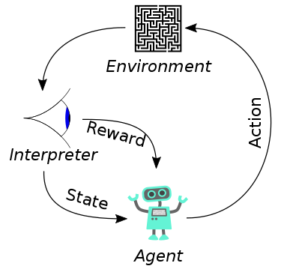
What is RL?
강화 학습이란?
  현재의 상태(State)에서 어떤 행동(Action)을 취하는 것이 최적인지를 학습하는 것이다.
https://upload.wikimedia.org/wikipedia/commons/thumb/1/1b/Reinforcement_learning_diagram.svg/375px-Reinforcement_learning_diagram.svg.png

Slide 5
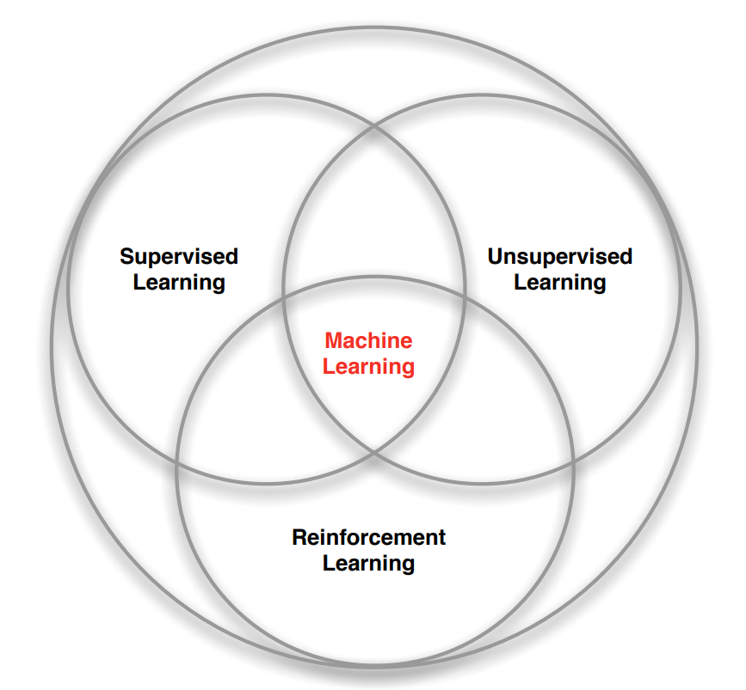
Difference from other paradigms
  No supervisor, only a reward signal
  Feedback is delayed, not instantaneous
  Time really matters (sequential, non i.i.d data)
  Agent’s actions affect the subsequent data it receives

Slide 6
  Language Models

Slide 7
Key limitation
Generate violates human preferences
  misinformation
  offensive language
  factually incorrect summaries
To alleviate, generate text that scores highly according to human preference
  Learn from human feedback -> problem: limited information

Slide 8
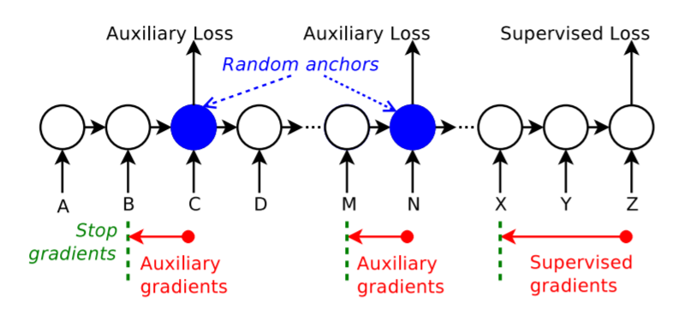
Auxiliary loss
학습을 잘 하기 위한 보조적인 loss
Hidden state 중간에 loss를 적용하는 방식
Not straightforwardly generalized

Slide 9
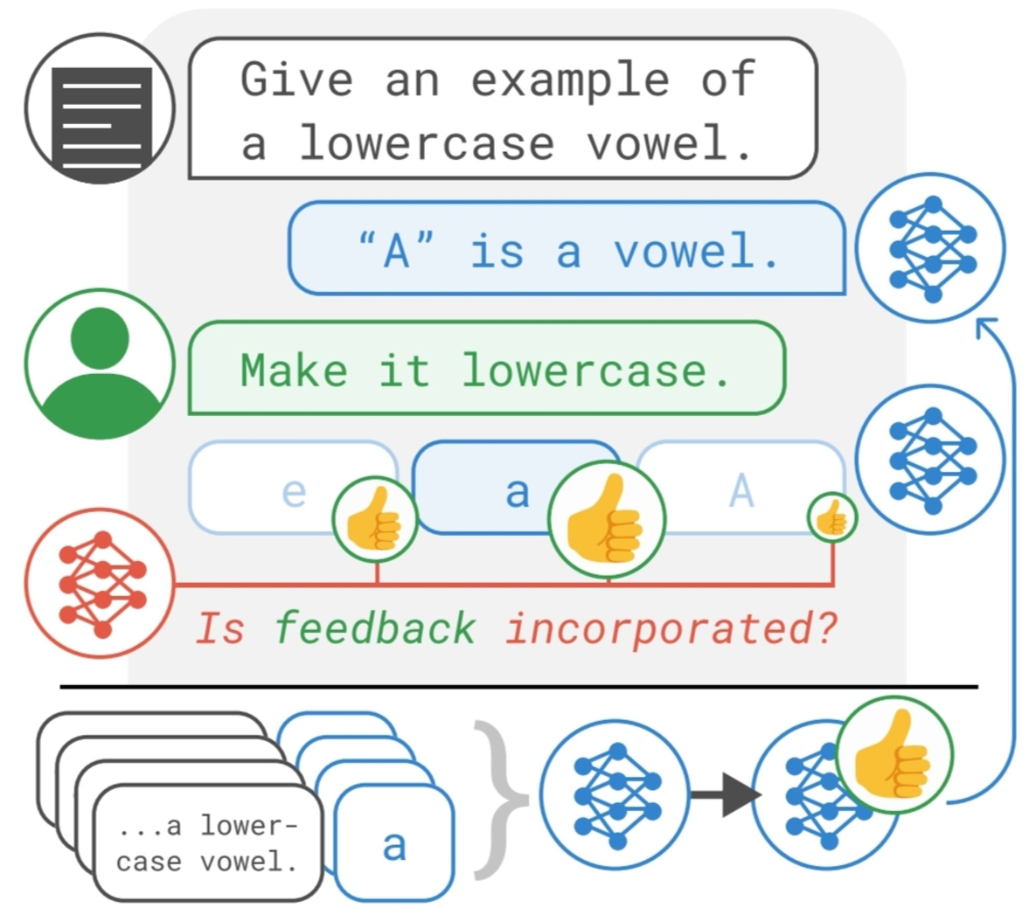
ILF(Imitation learning from Language Feedback)
1. Generate multiple refinements
2. Use instruction-finetuned LM to choose the refinement
3. finetune the LM that generated the initial output on the chosen refinement

Slide 10


Language feedback as Bayesian Inference
Goal : produce high-quality output for context
Use LM to generate output by conditioning on the context
Data-generating process :
Output is high quality according to human preference when

Slide 11


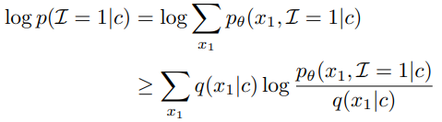
Language feedback as Bayesian Inference
Goal : maximizing
Approximate by using ELBo

Slide 12

Language feedback as Bayesian Inference
Using Expectation-Maximization procedure: alternating between maximizing E-step and M-step
E-step : q에 관해 F를 최대화하는 것
M-step : 에 관해 F를 최대화하는 것
Imitation learning from Language Feedback

Slide 13

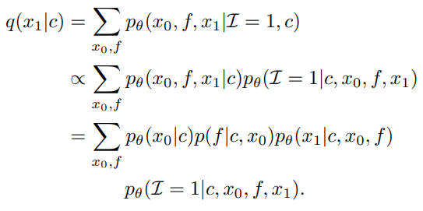
Language feedback as Bayesian Inference
E-step : Maximizing w.r.t q
High quality text에 더 높은 우도를 할당하기 위해 q를 개선하는 것과 동일

Slide 14

Language feedback as Bayesian Inference
Model as a Boltzmann distribution:

Slide 15
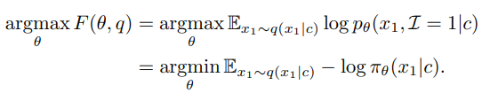
Language feedback as Bayesian Inference
M-step : Maximizing w.r.t πθ
Q에 의해 정의된 분포에서 cross-entropy loss를 최소화하는 하는 것과 동일

Slide 16

Language feedback as Bayesian Inference
Implement R by condition an instruction-finetuned LM on a binary question
Prompt가 주어졌을 때 positive answer의 probability를 reward로 사용

Slide 17



Language feedback as Bayesian Inference
To obtain a sample
sample N refinements
Compute

Slide 18
Difference other works
Previous works use language feedback at test time to correct mistakes
ILF uses feedback to train models
This approach does not require human intervention at test time

Slide 19
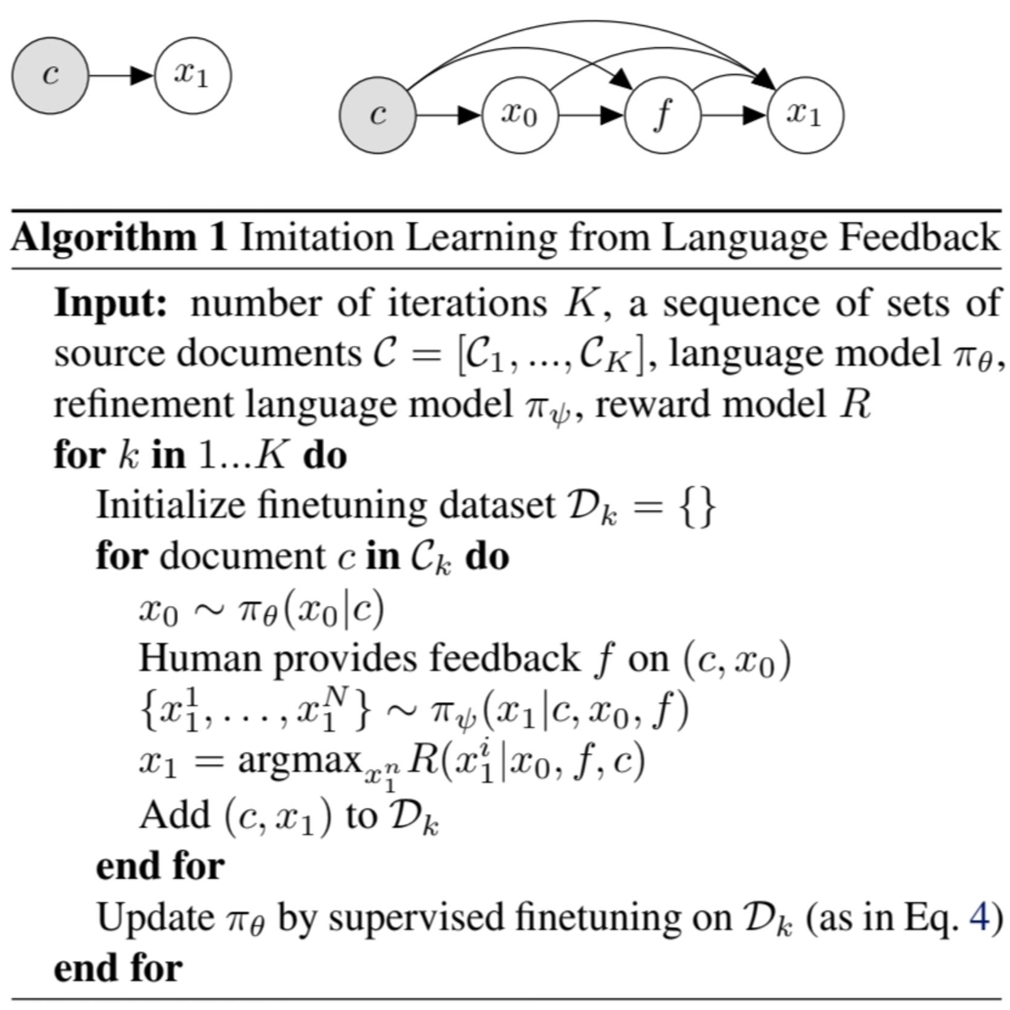
ILF Algorithm
a)
b)
a) graphical model of the target distribution : p(c|x1)
b) graphical model of the proposal distribution : q(c|x1)

Slide 20
  Method

Slide 21
Method
To generate improved output x1: high-quality summaries
f : given language feedback
x0 : initial model-generated output x0
c : context(e.g., source document)
πθ : language model
R : reward function

Slide 22

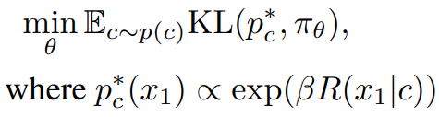
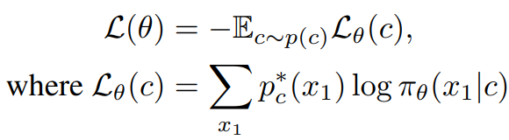
Method
c is drawn from context distribution p(c)
R로 측정된 output의 quality에 비례하는 ground truth distribution
에 근접하도록 LM을 finetuning

Slide 23

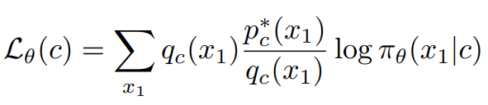
Method
x1의 규모가 지수적으로 커지고 의 정규화 상수를 정확하게 계산하는 것이 불가능
같은 이유로 Loss function를 완벽하게 계산하지 못함
직접 샘플링을 할 수 있는 에서 중요도 샘플링을 사용

Slide 24

Method
분산을 최소화하기 위해 을 에 가깝게 설계해야 함
1. c에서 LM으로부터 x0를 선택
2. 사람이 x0을 평가하고 (c, x0) pair에 대한 language feedback f를 제공
3. refinement LM이 (c, x0, f) pair에 대해 refine된 output x1을 생성

Slide 25


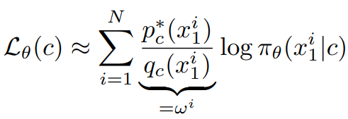
Method
N개의 summaries 을 에서 샘플링
ω i : importance weight (not computable) -> assume that is constant

Slide 26
  Experiment

Slide 27
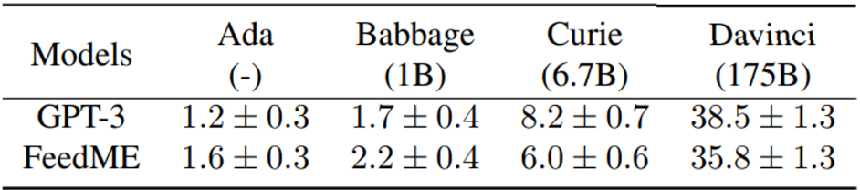
Experiment
Set up – choose model & size
  Generate one output per sample with greedy decoding
  Use differently-sized GPT-3 models
  Take 175B parameter models & FeedME(instruction-finetuned model)

Slide 28
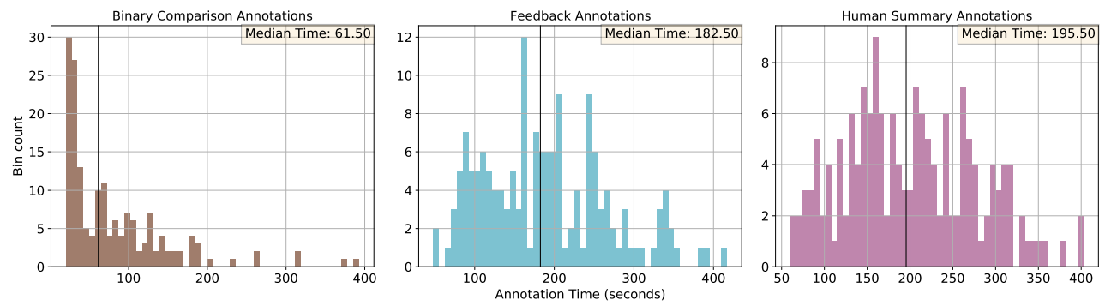
Experiment
Text summarization on ILF
  Using TL;DR dataset
  language feedback by Surge AI

Slide 29
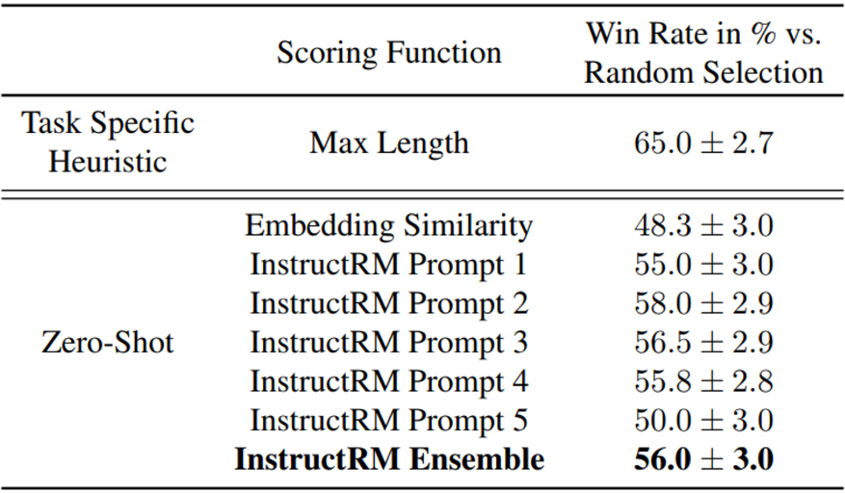
Experiment
Comparing Refinement Ranking Methods
  Condition FeedMe on the initial summaries of train dataset
  Scoring Refinements with InstructRM
  Five different prompts & select refinement
  with the highest average p(y|prompt)

Slide 30
Reward Model
Standard RM
LM의 마지막 embedding layer를 제거하고 scalar value를 출력하도록 학습
Reward Model with Language Output
Scalar 대신 언어 토큰을 출력하도록 학습
선택된 데이터셋을 사용하여 LM을 finetune, 를 최대화

Slide 31
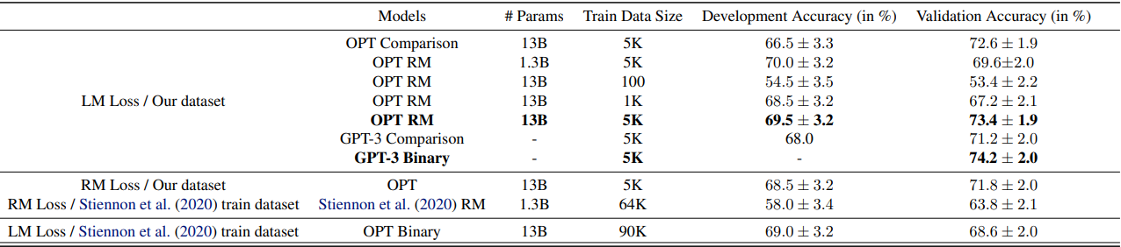
Reward Model
Evaluate various RMs

Slide 32
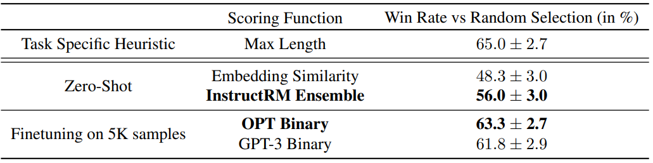
Reward Model
Compare reward models and ranking methods

Slide 33
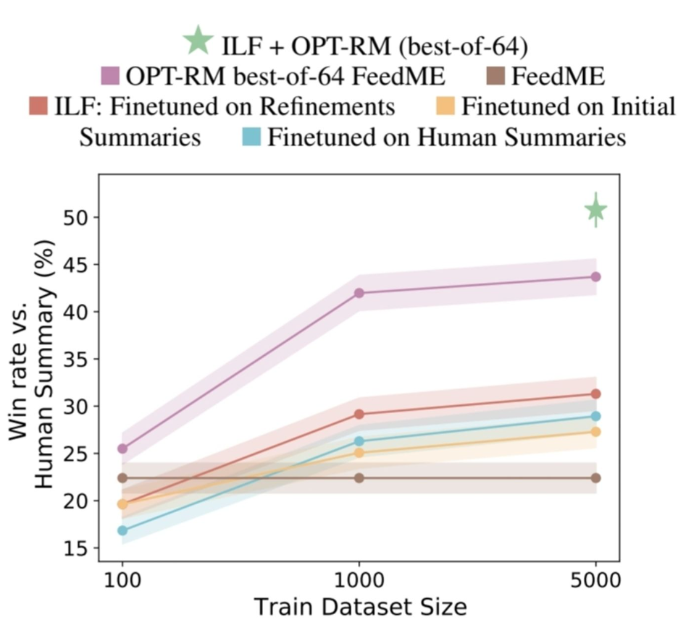
Experiment
Comparing Feedback Learning Algorithms
  Single iteration of ILF
  Human-written summaries
  Initial summaries
  Best-of-N
  ILF + Best-of-N

Slide 34
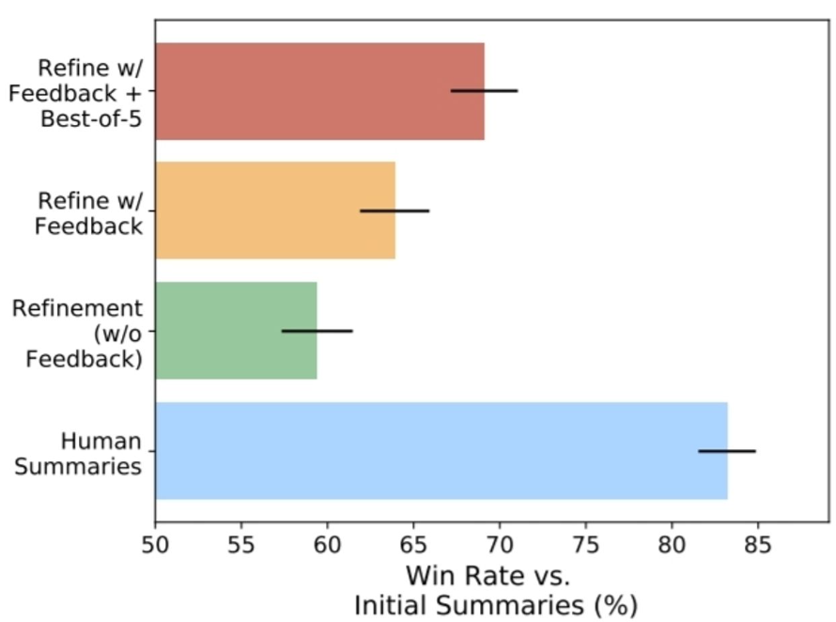
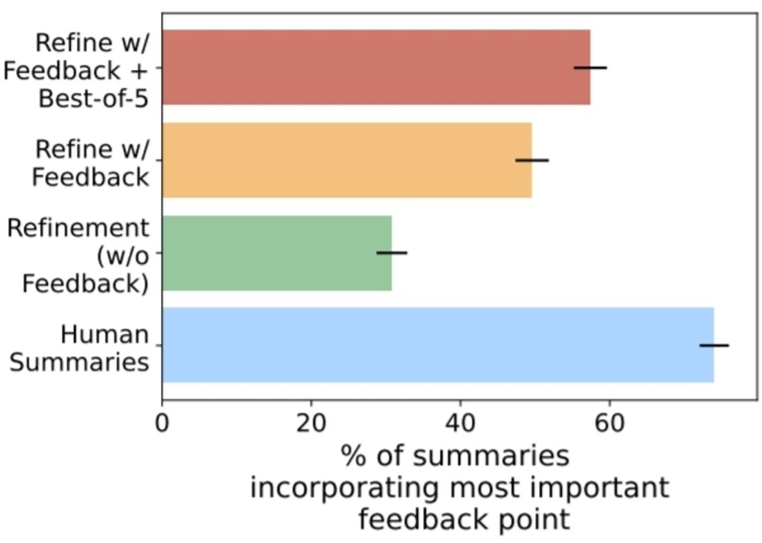
Ablation Study

Slide 35
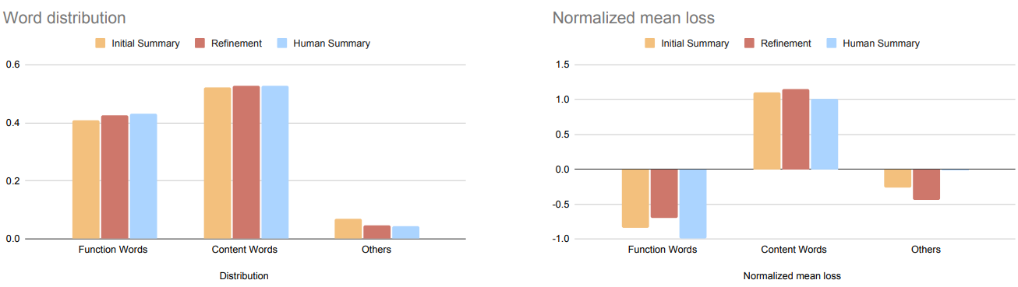
Distribution of tokens of various finetuning datasets

Slide 36
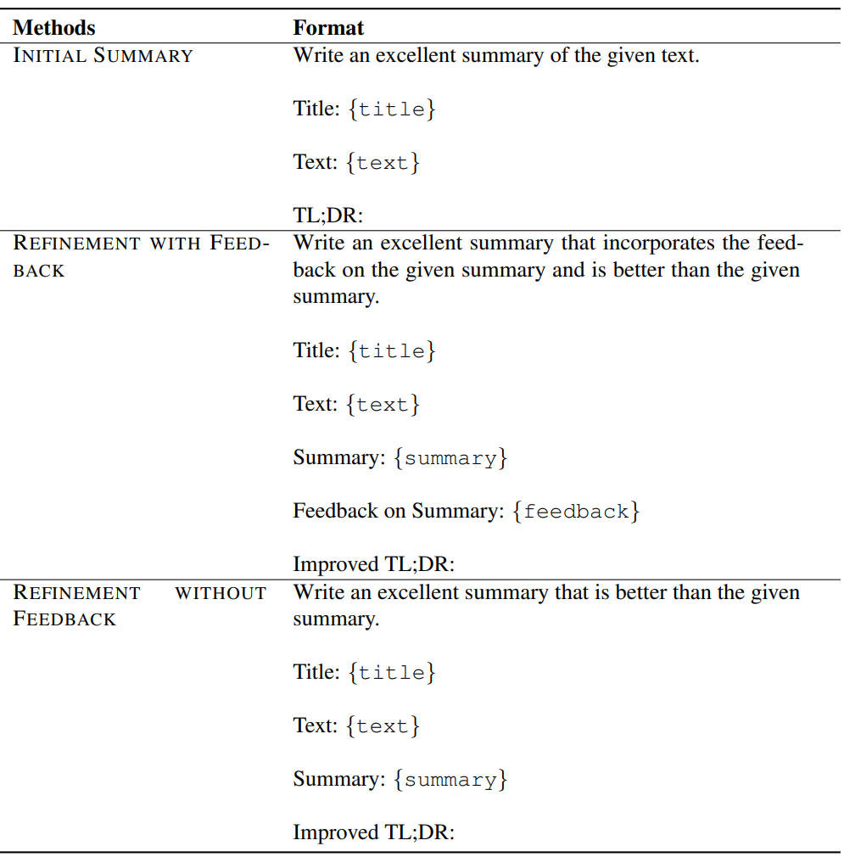
Prompts
Summarization Prompts

Slide 37
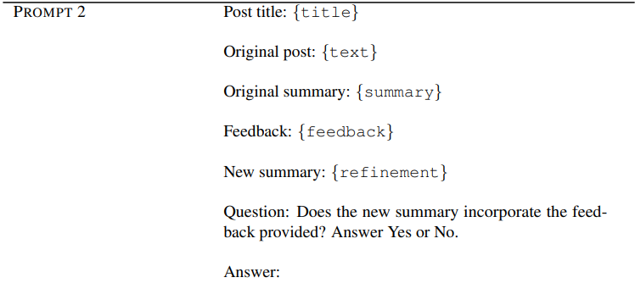
Prompts
InstructRM Prompts
Example: Prompt2

Slide 38
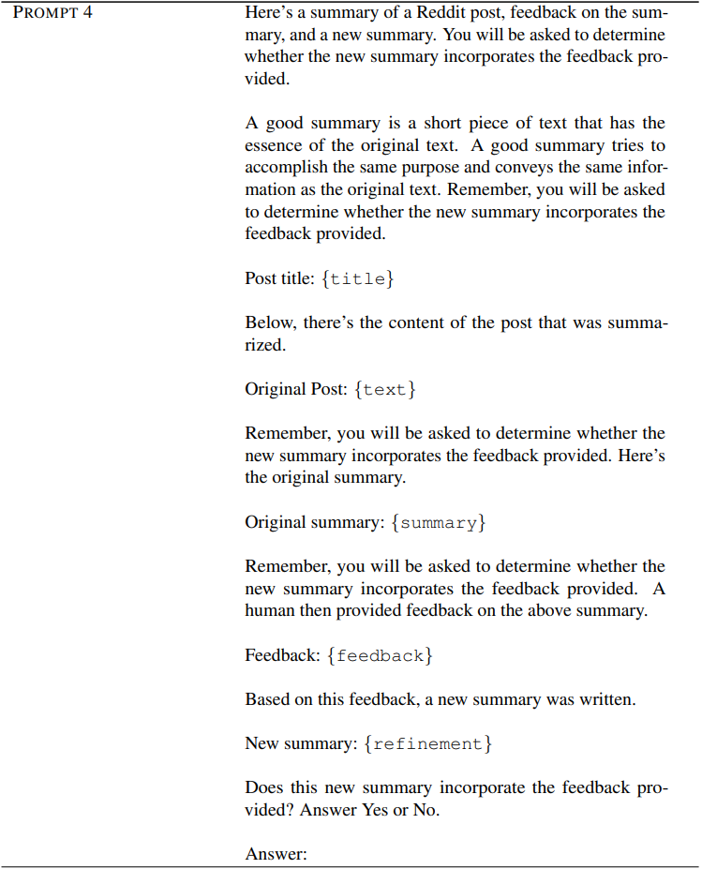
Prompts
InstructRM Prompts
Example: Prompt4

Slide 39
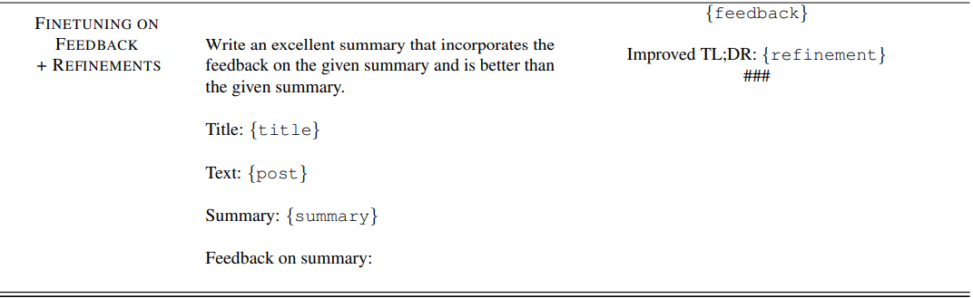
Prompts
Finetuning Prompts

Slide 40
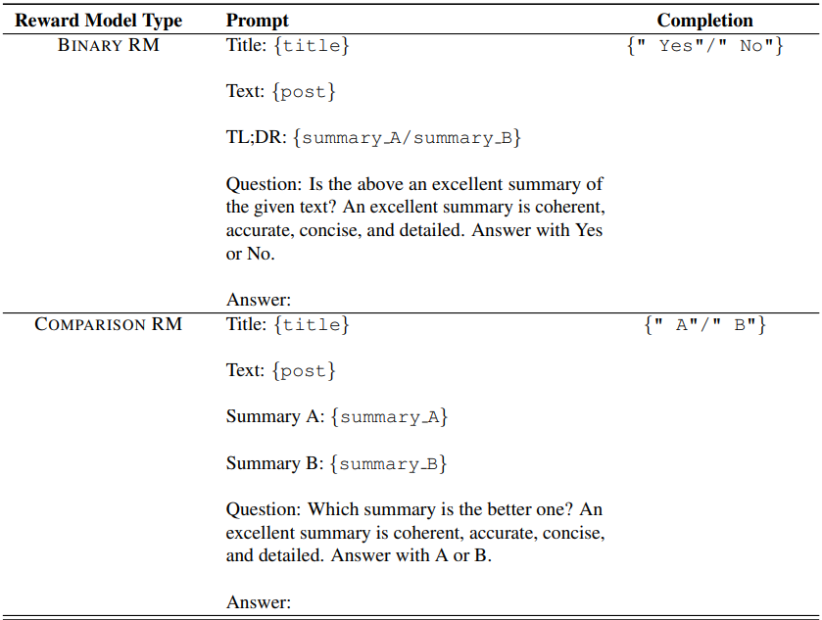
Prompts
Reward Model Prompts

Slide 41
  Discussion

Slide 42
Reference
‘강화 학습이란‘, https://ko.wikipedia.org/wiki/%EA%B0%95%ED%99%94_%ED%95%99%EC%8A%B5
Training Language Models with Language Feedback at Scale. 2023, https://arxiv.org/abs/2303.16755
Auxiliary Loss, https://seqml.github.io/a2ls/

